Slide 1

Docker 102
https://github.com/Akamiz96/docker_course

Slide 2
¿Qué es Docker?
Virtualización y Contenedores

Slide 3
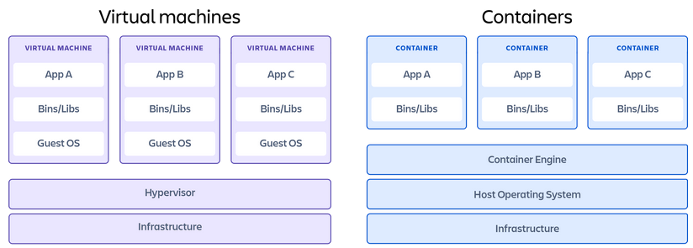
Contenedores Vs. Máquinas Virtuales
Tomado de: https://www.atlassian.com/es/microservices/cloud-computing/containers-vs-vms

Slide 4
Primeros pasos con Docker
“Hola Mundo”

Slide 5
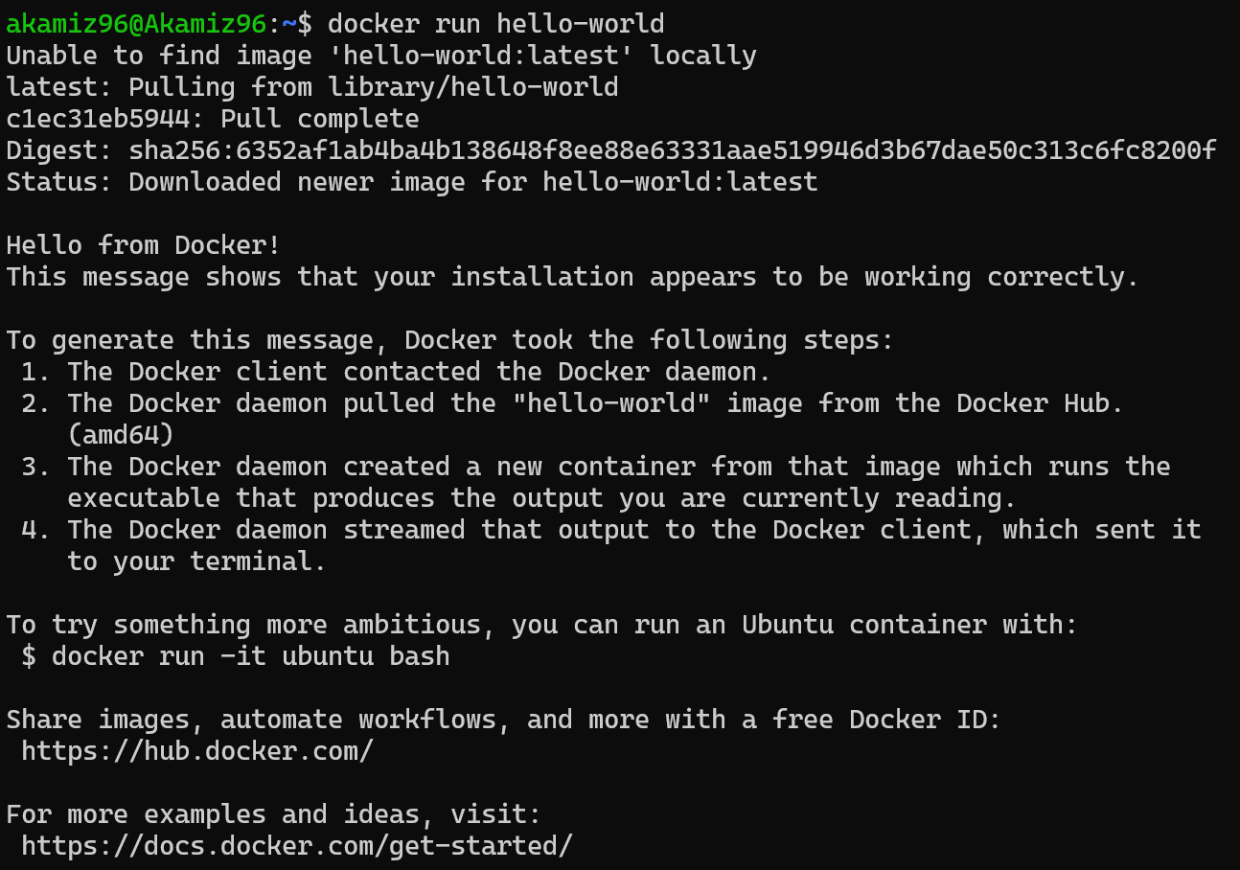
docker run hello-world

Slide 6
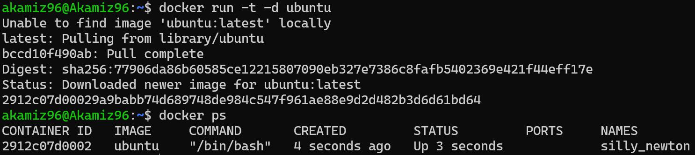
docker run –t –d ubuntu

Slide 7
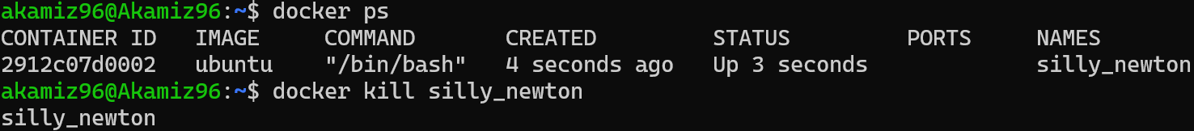
docker ps

Slide 8
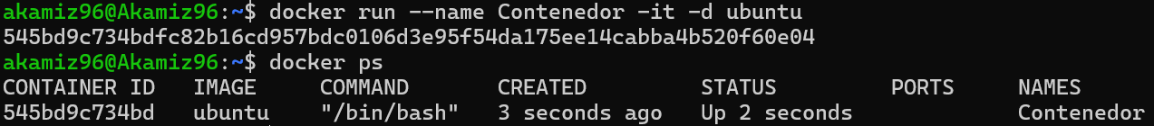
docker run –name Contenedor –it –d ubuntu

Slide 9
Construyendo con Docker
Creando contenedores propios

Slide 10

Dockerfile
Tomado de: https://cto.ai/blog/docker-image-vs-container-vs-dockerfile/

Slide 11
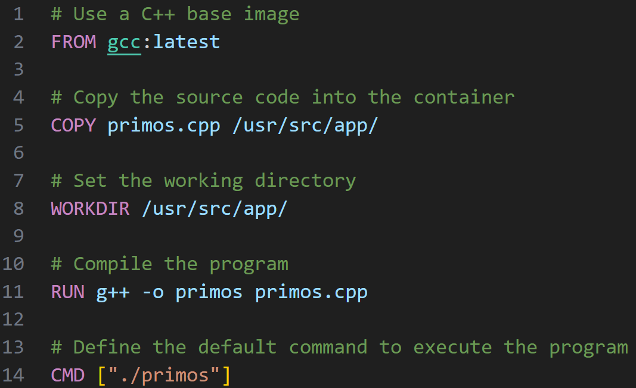
Dockerfile

Slide 12
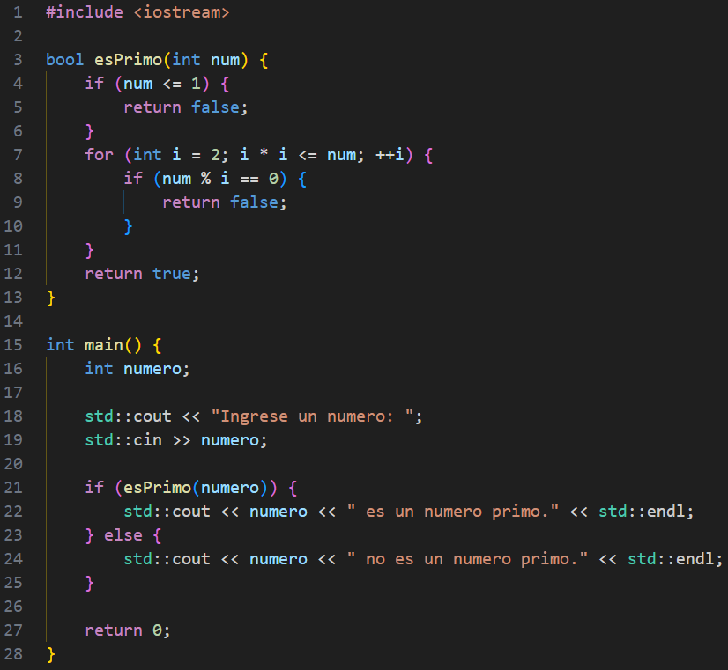

Slide 13
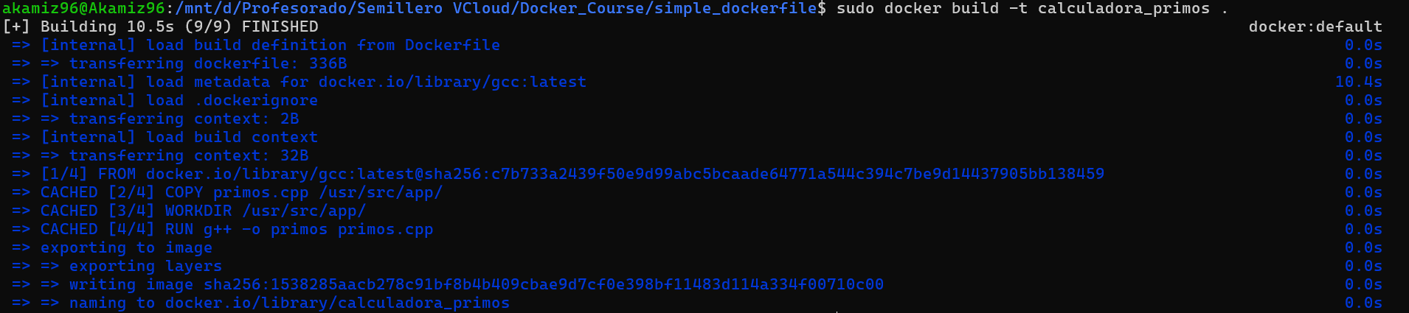
Dockerfile - build
docker build -t calculadora_primos .
Tag

Slide 14
Dockerfile - run
docker run calculadora_primos
docker run -it calculadora_primos

Slide 15
Dockerfile - variados
docker ps --all
docker run --name calculadora -it -d calculadora_primos
docker ps

Slide 16
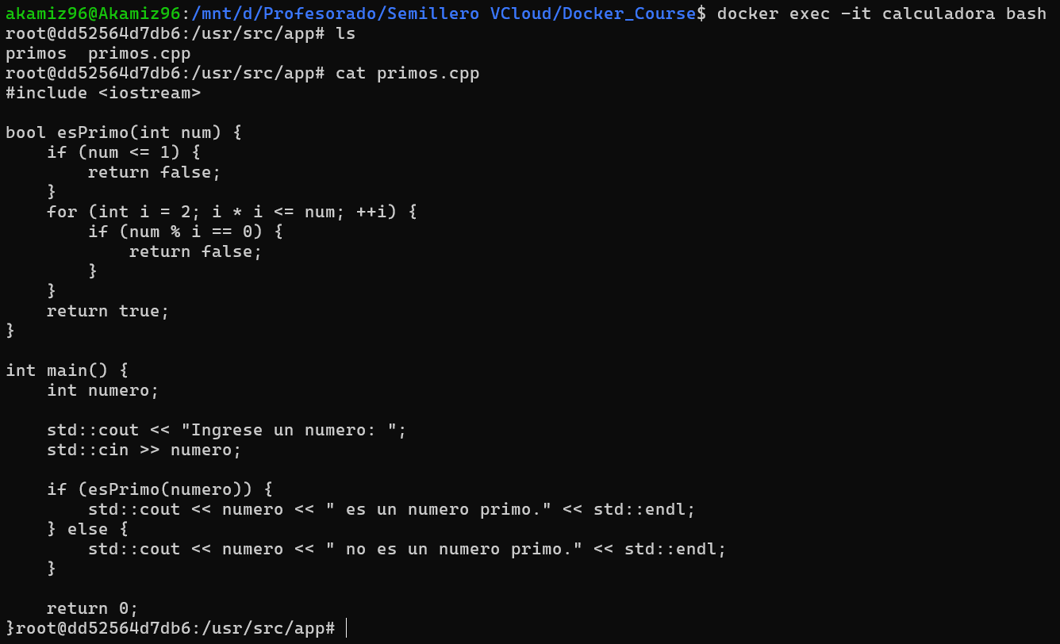
Dockerfile - variados
docker exec -it calculadora bash

Slide 17
Exponer puertos
Uso de servicios dentro de Docker

Slide 18
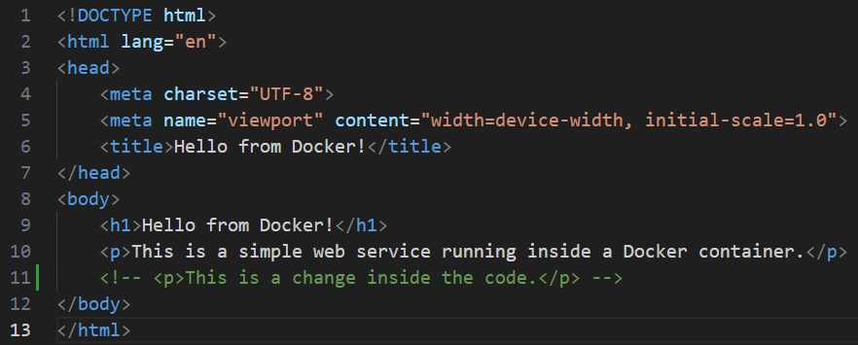
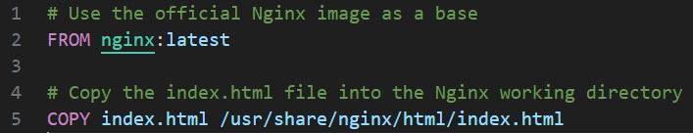
Index.html
Dockerfile

Slide 19
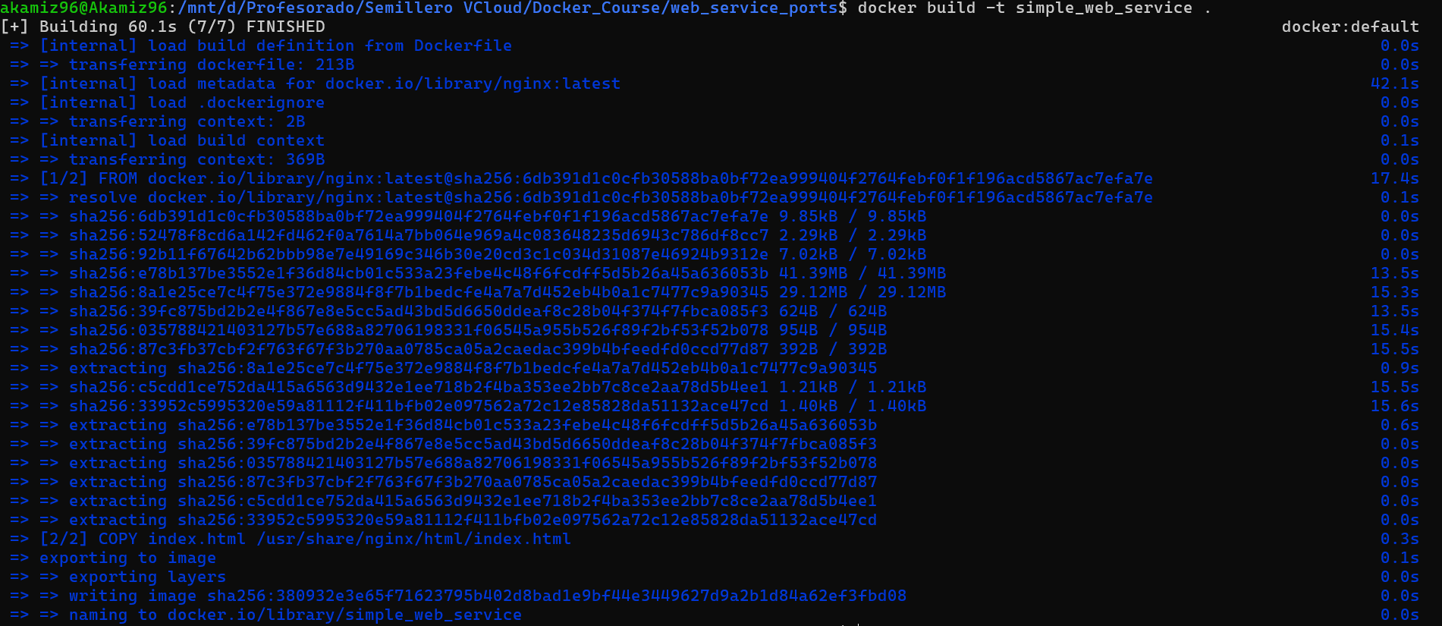
docker build -t simple_web_service .

Slide 20
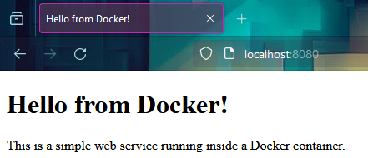
docker run -d -p 8080:80 simple_web_service
localhost:8080

Slide 21
docker run -d -p 8080:80 simple_web_service
docker ps

Slide 22
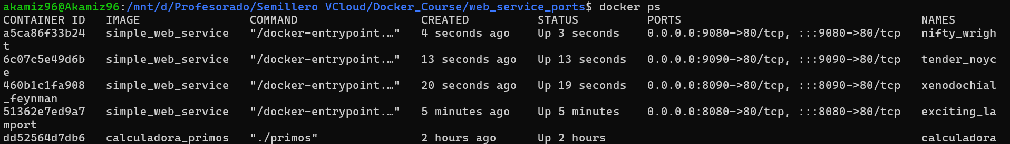
docker run -d -p 8090:80 simple_web_service
docker run -d -p 9090:80 simple_web_service
docker run -d -p 9080:80 simple_web_service
docker ps

Slide 23
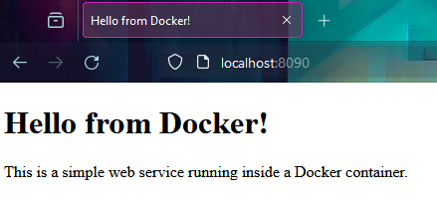
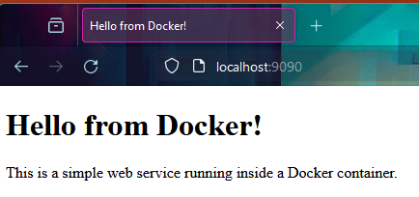
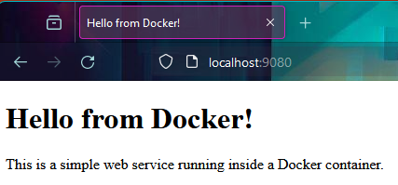

Slide 24
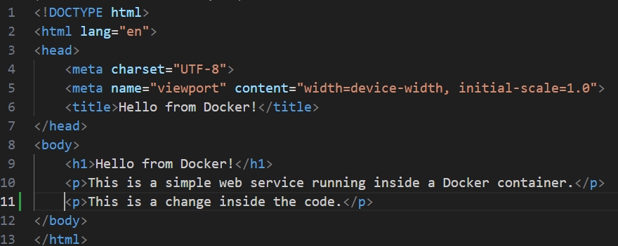
Index.html

Slide 25
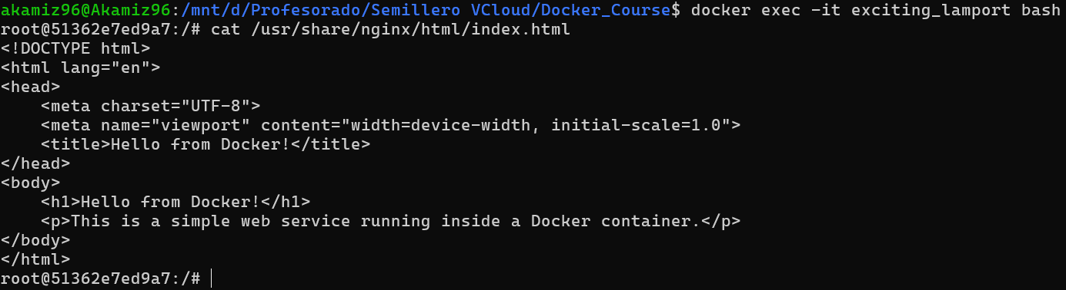
docker ps
docker exec -it exciting_lamport bash
cat /usr/share/nginx/html/index.html

Slide 26
Volúmenes en Docker
Persistencia de datos

Slide 27
Index.html
Dockerfile

Slide 28
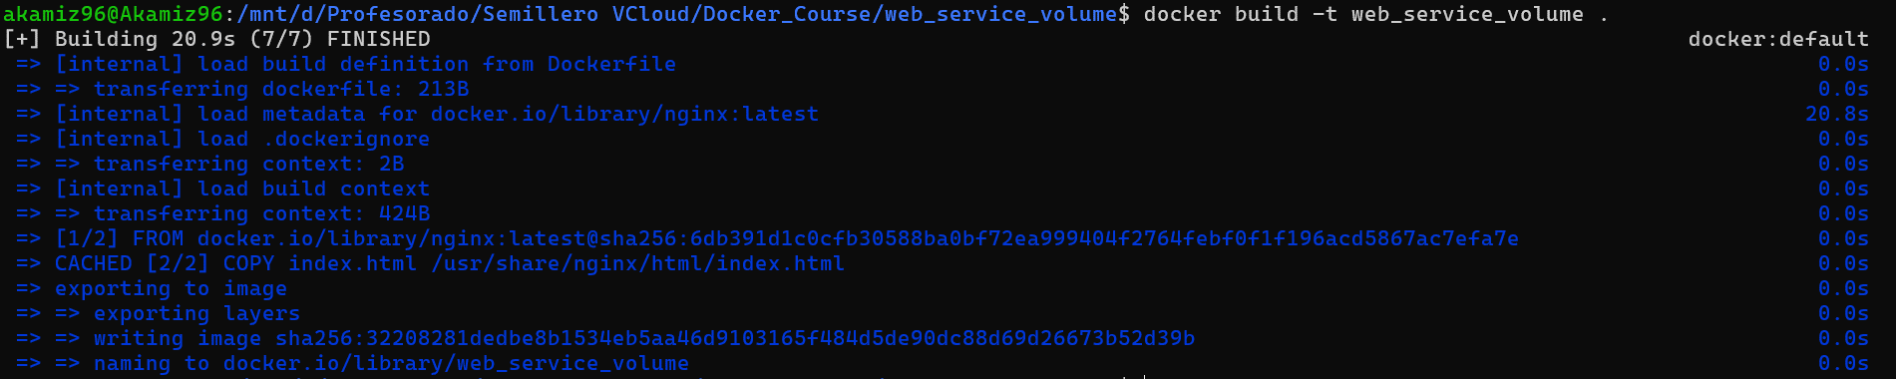
docker build -t web_service_volume .

Slide 29
docker run -d -p 8080:80 -v .:/usr/share/nginx/html web_service_volume
localhost:8080

Slide 30
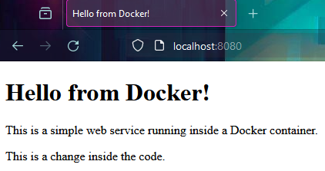
Index.html

Slide 31

Ejemplo con entrada y salida

Slide 32
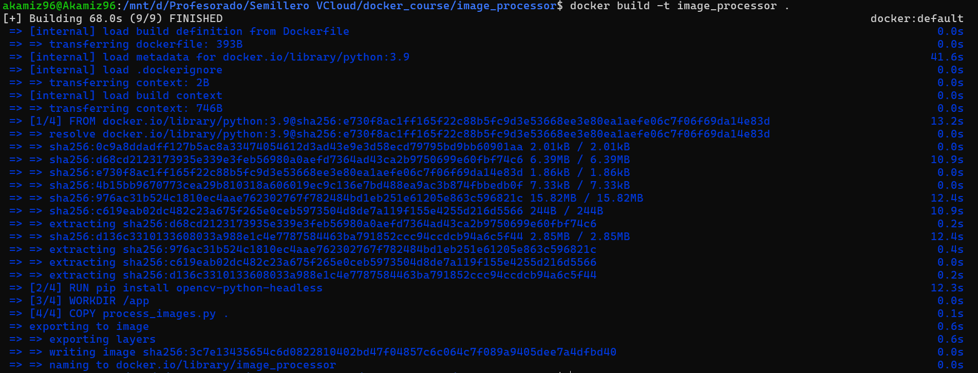
docker build –t image_processor .

Slide 33
docker run -v "$(pwd)/input_images:/input_images" -v "$(pwd)/output_images:/output_images" image_processor

Slide 34

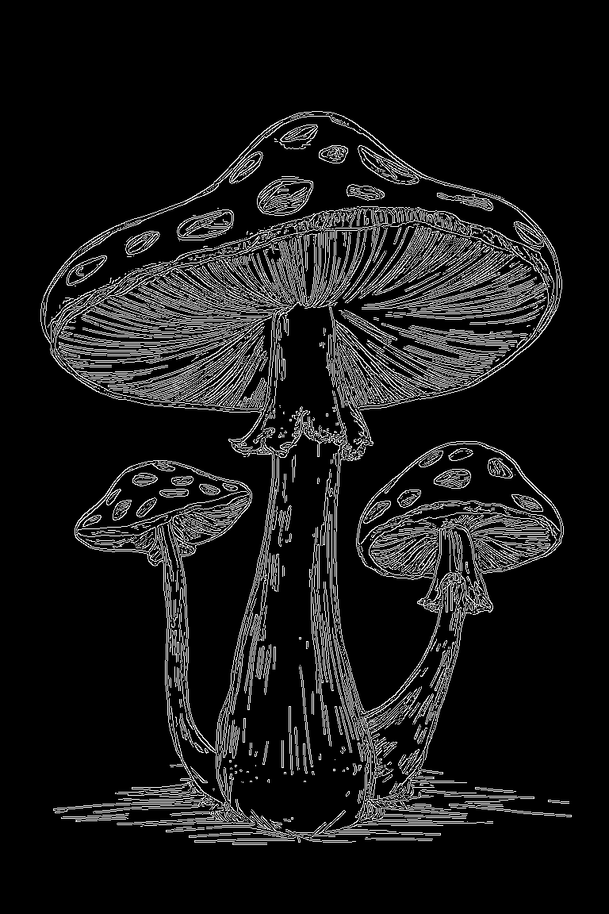

Slide 35



Slide 36



Slide 37
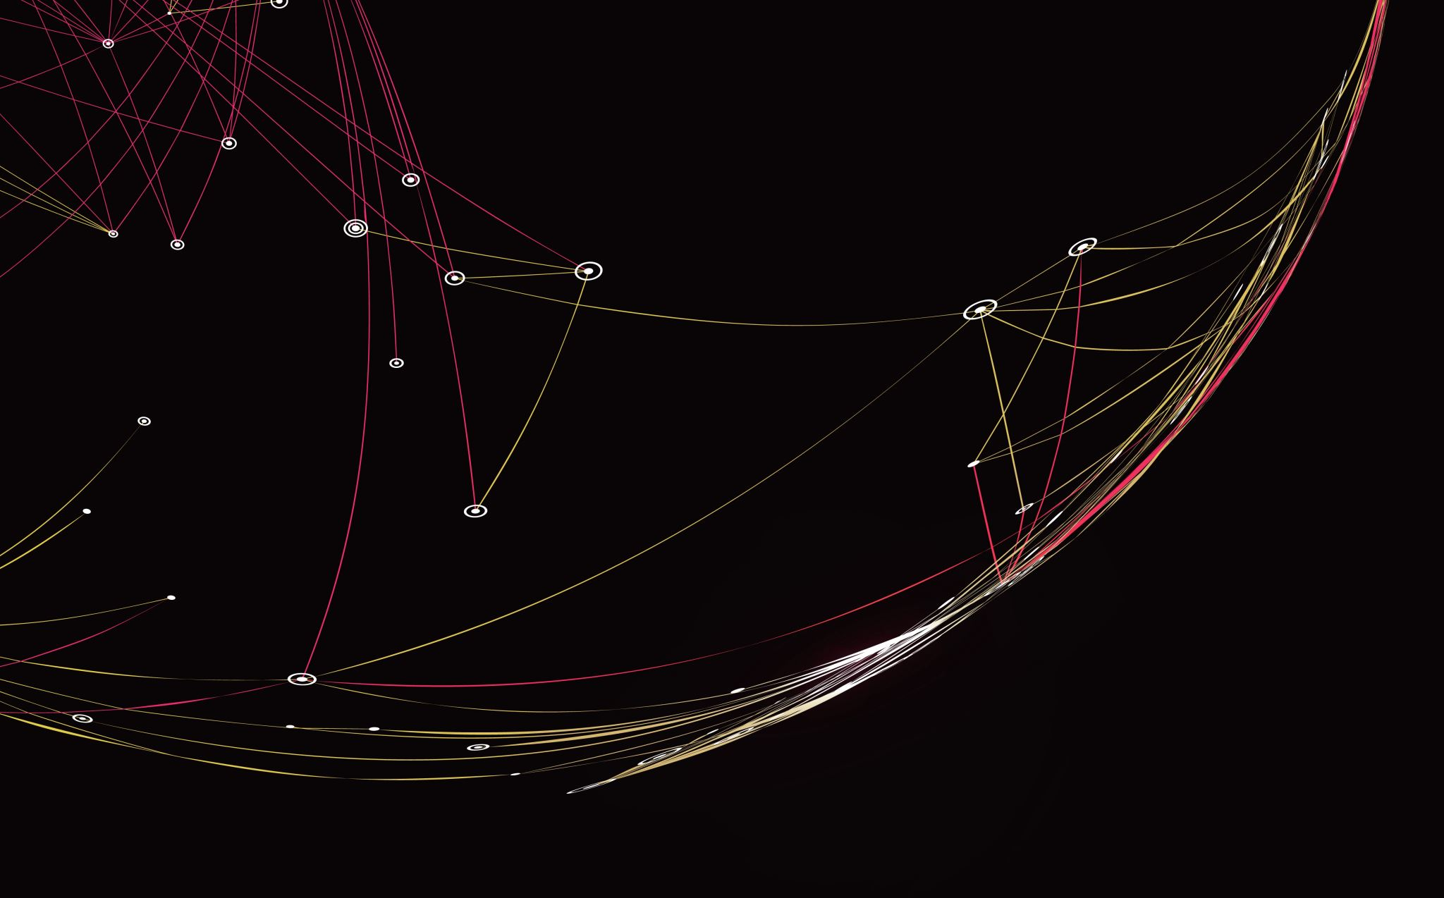
Ejemplo comunicación

Slide 38
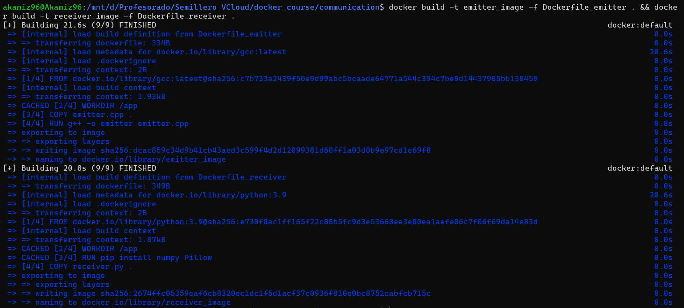
docker build -t receiver_image -f Dockerfile_receiver . &&
docker build -t emitter_image -f Dockerfile_emitter .

Slide 39
docker run -d --name receiver -v "$(pwd)/shared_folder:/shared_folder" -v "$(pwd)/output_images:/output_images" receiver_image
docker run -d --name emitter -v "$(pwd)/shared_folder:/shared_folder" emitter_image

Slide 40
docker ps

Slide 41


Slide 42
docker kill emitter && docker kill receiver

Slide 43
Docker Networks
Conectando contenedores

Slide 44
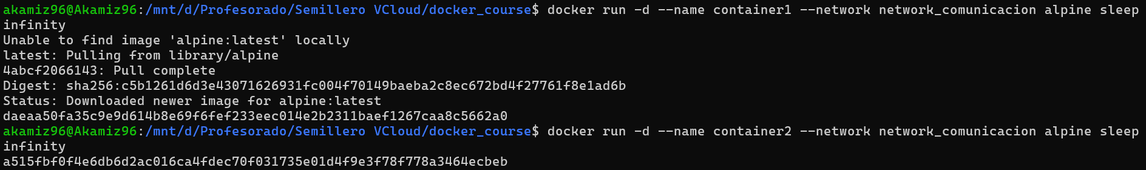
docker network create network_comunicacion
docker network create network_aislada
docker run -d --name container1 --network network_comunicacion alpine sleep infinity
docker run -d --name container2 --network network_comunicacion alpine sleep infinity

Slide 45
docker ps
docker run -d --name container3 --network network_aislada alpine sleep infinity

Slide 46
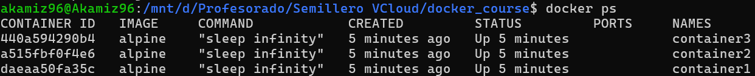
docker ps

Slide 47
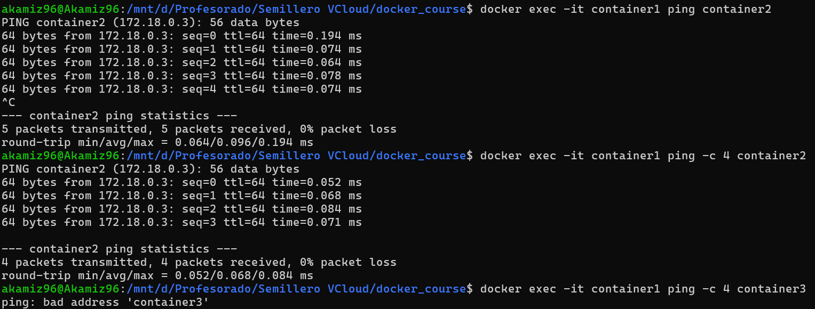
docker exec -it containerX ping -c 4 containerX

Slide 48
Próximos pasos
Recursos adicionales

Slide 49
Volúmenes
https://docs.docker.com/storage/volumes/
https://medium.com/@nickjabs/docker-volumes-tutorial-56c9cc69c31e
https://aws.plainenglish.io/the-ultimate-guide-to-docker-volumes-812498a4d996
https://www.youtube.com/watch?v=Wh4BcFFr6Fc

Slide 50
Redes - Networking
https://docs.docker.com/network/
https://spacelift.io/blog/docker-networking
https://docs.docker.com/engine/tutorials/networkingcontainers/
https://medium.com/@MetricFire/understanding-docker-networking-9f81244cf824

Slide 51

Muchas gracias

